Slide 1

STUDY ON FREE SPACE
OPTICAL COMMUNICATION
2020UEI2801 LAKSHAY
2020UEI2810 DEEPANSHU
2020UEI2812 DEEPANSHU MEHANDIA
2020UEI2849 BHISHEK RANGA

Slide 2
CONTENTS
INTRODUCTION
OPTISYSTEM
AIMS/OBJECTIVE OF PROJECT
FUTURE WORKS TO BE DONE
EXPECTED OUTPUTS/OUTCOME OF THE WORK
REFERENCES

Slide 3
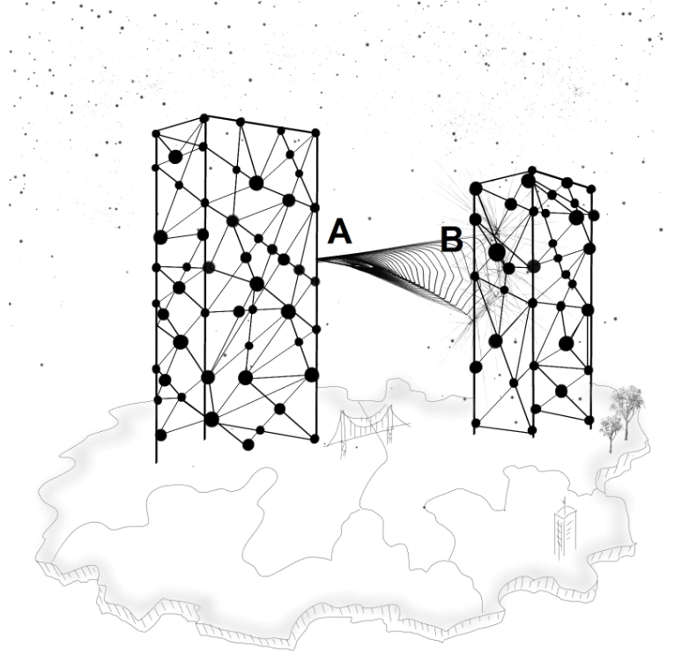
INTRODUCTION
FSO stands for "Free Space Optical" communication,
also known as optical wireless communication(OWC).
Modulated beams of light(IR spectrum )
is used to transmit data.
All transmission happens in free space
Range is short to medium distances.
Works on line-of-sight propagation.

Slide 4
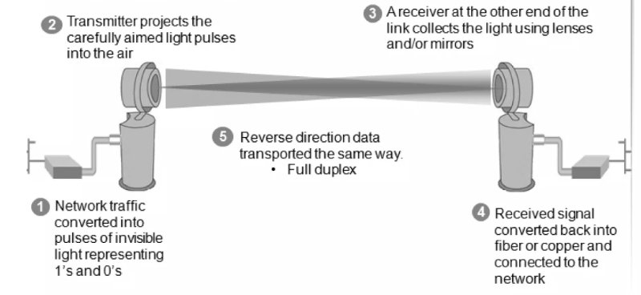
HOW DOES FSO WORKS ?

Slide 5
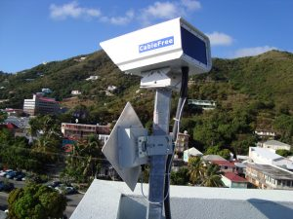
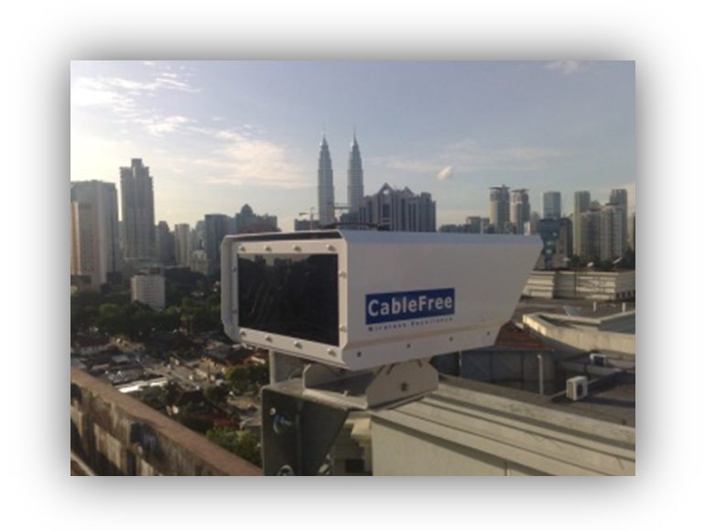
CHARACTERISTICS OF FSO COMMUNICATION
Line of Sight Communication
High Data Rate
Low Latency
No Spectrum licensing
Security
Immunity of Electromagnetic
Interference
No Physical Cables
Energy Efficiency

Slide 6
ADVANTAGES OF FSO
High Data Rates
Security
No Spectrum Licensing
Quick Deployment
Energy Efficiency
DISADVANTAGES OF FSO
Line of Sight(LOS) requirement
Weather Dependence
Limited Range
Security Challenges
Interference from Ambient Light

Slide 7
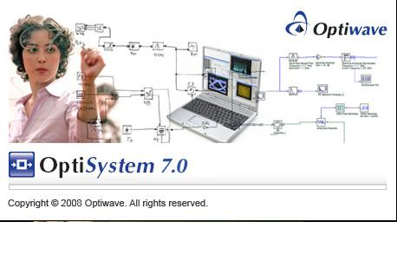
OPTISYSTEM
OptiSystem is a software tool used for designing, testing, and simulating optical communication systems. It's a powerful simulation platform that enables engineers and researchers to model and analyze the performance of optical systems before actual implementation.
GUI(Graphical User Interface)
Extensive Component Library
Simulation and Analysis Tool
Optical Fibre Communication Modelling
Educational Use
Integration Capabilities
Documentation and support

Slide 8
AIM
Simulation of a FSO network in the Optisystem Software
Connecting two areas of Delhi in Optisystem via FSO
Study the data transfer rate in every weather in the simulated area
Improve the efficiency of the transfer rate in every weather
Plot the Graph of variation of Q factor with respect to the used wavelengths at each node for clear season, hasty season and rainy season
Plot the received output eye diagram (1550 nm) at different nodes for clear season, hasty season and rainy season

Slide 9
Network Topologies used in Project
Bus Topology
Ring Topology
Hybrid Topology

Slide 10
Bus Topology
All networked nodes are interconnected, peer to peer, using a single, open-ended cable
Both ends of the bus must be terminated with a terminating resistor to prevent signal bounce

Slide 11
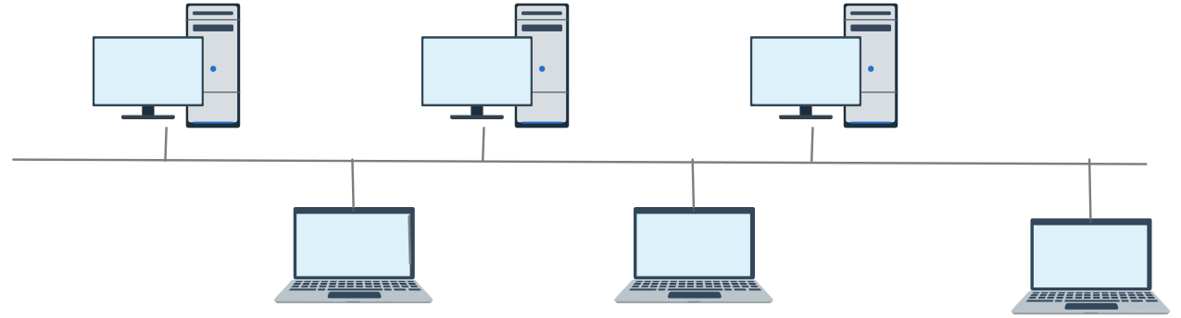
Bus Topology

Slide 12
2. Ring Topology
Started out as a simple peer-to-peer LAN topology
Each networked workstation had two connections: one to each of its nearest neighbors
Data was transmitted unidirectional around the ring

Slide 13
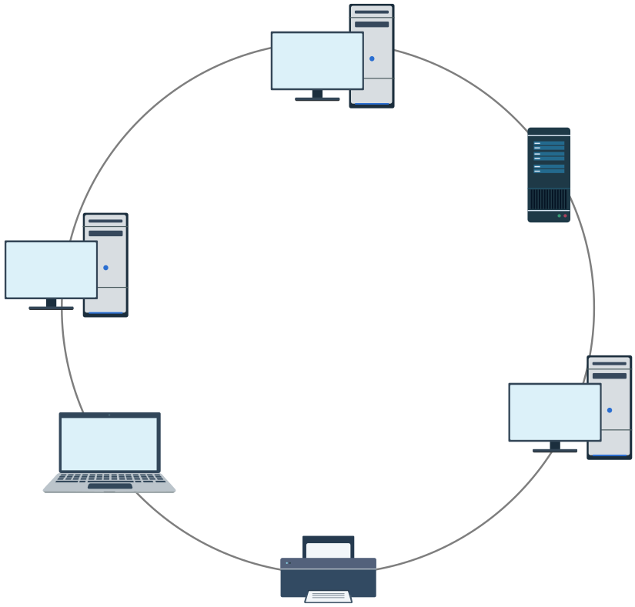
Ring Topology

Slide 14
Weather in New Delhi, INDIA
The climate of New Delhi is a dry-winter humid subtropical climate bordering on a hot semi-arid climate with high variation between summer and winter in terms of both temperature and rainfall. The temperature varies from 46 °C (115 °F) in summers to around 0 °C (32 °F) in winters. The area's version of a humid subtropical climate is noticeably different from many other cities with this climate classification in that it features long and very hot summers with dust storms, relatively dry and mild winters with wildfire haze, and a monsoonal period. Summers are long, extending from early April to October, with the monsoon season occurring in the middle of the summer. Winter starts in November and peaks in January.

Slide 15
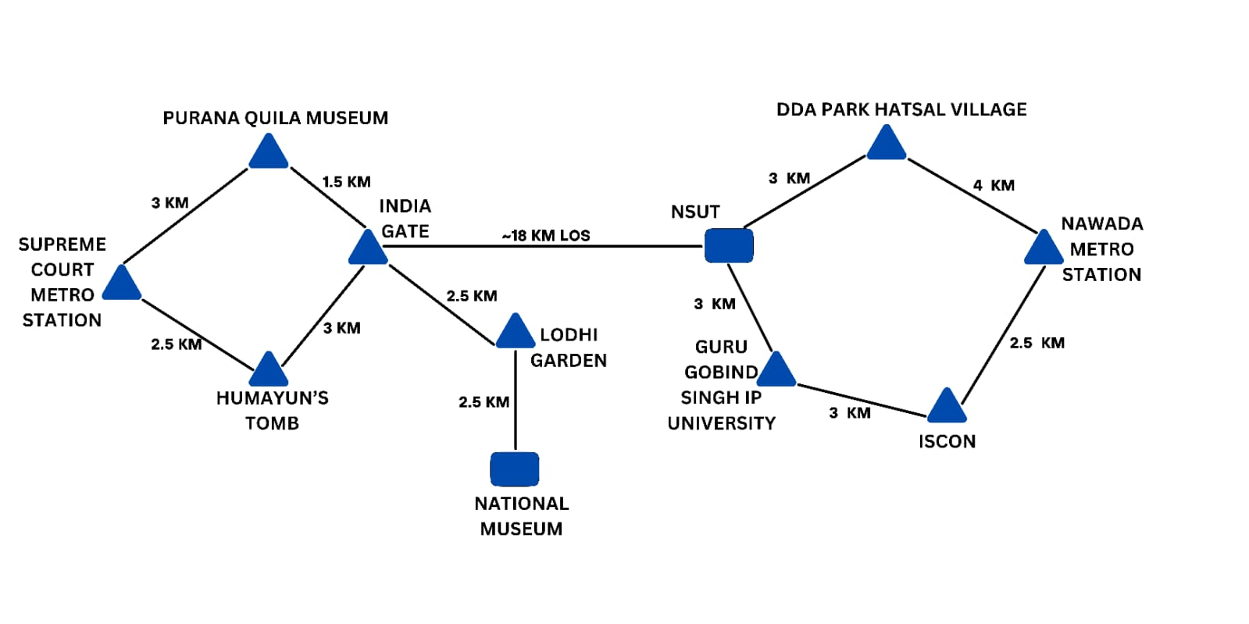
Architecture of FSO Network

Slide 16
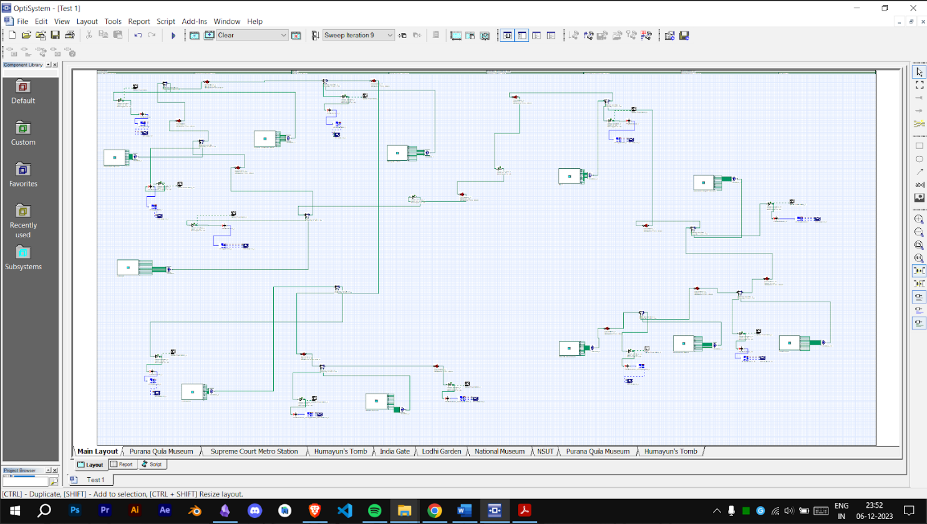
SIMULATED SETUP OF CLEAR WEATHER CONDITION

Slide 17
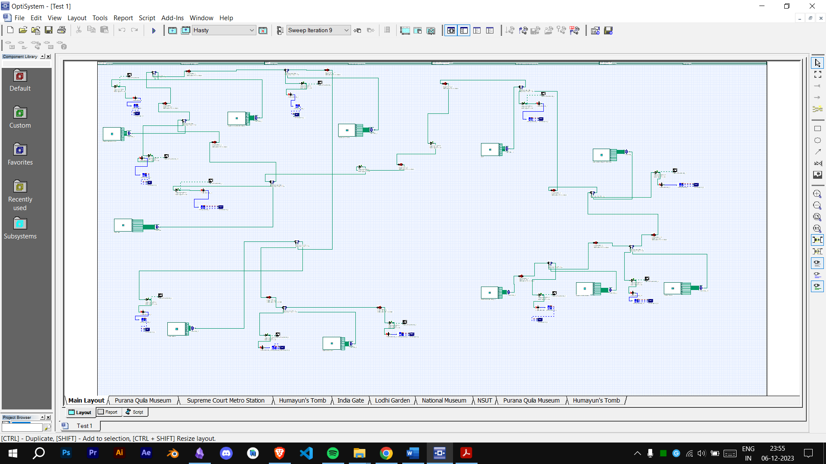
SIMULATED SETUP OF HASTY WEATHER CONDITION

Slide 18
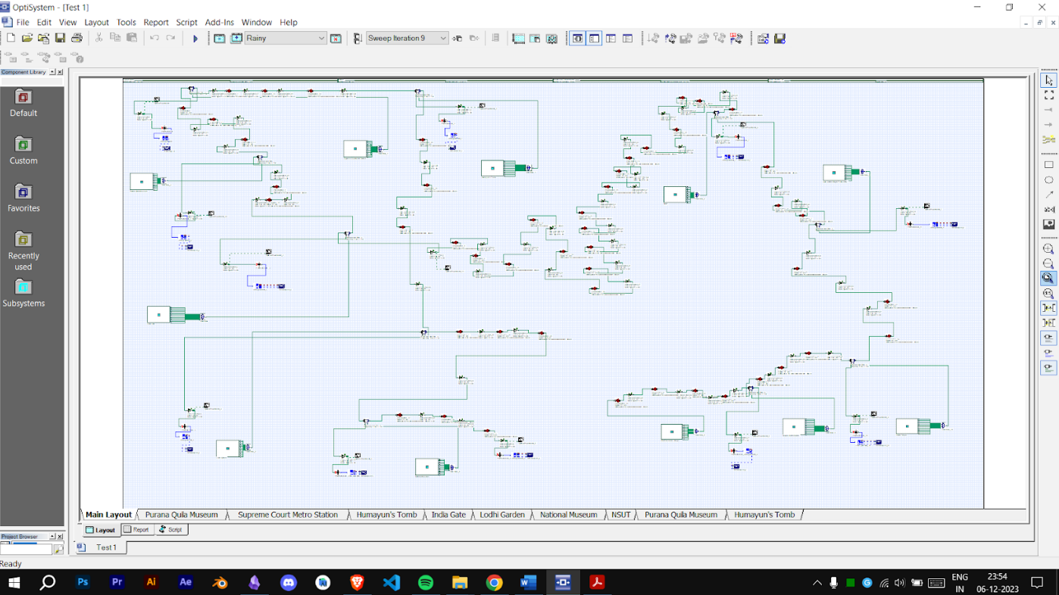
SIMULATED SETUP OF RAINY WEATHER CONDITION

Slide 19
Season details with respective Attenuation:
Weather Season | Time Duration | Attenuation (dB/km)
Clear Season | March to Last June | 0.23
Rain Season | July to September & September to October | 9.64
Haze Season | December to February | 2.37

Slide 20
Parameters of FSO Channel
Parameters | Range
Input power | Clear weather: 20 dB Foggy weather: 30 dB Rainy weather: 40 dB
Wavelength | 1550 nm onwards (12 channels with equal channel spacing of 0.5 nm)
Bit rate | 5 Gbps

Slide 21
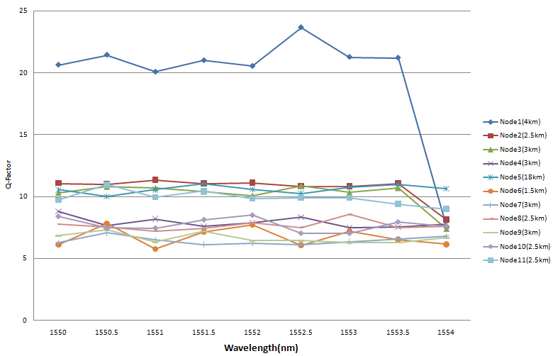
Graph of variation of Q factor with respect to the used wavelengths at each node for clear season.

Slide 22
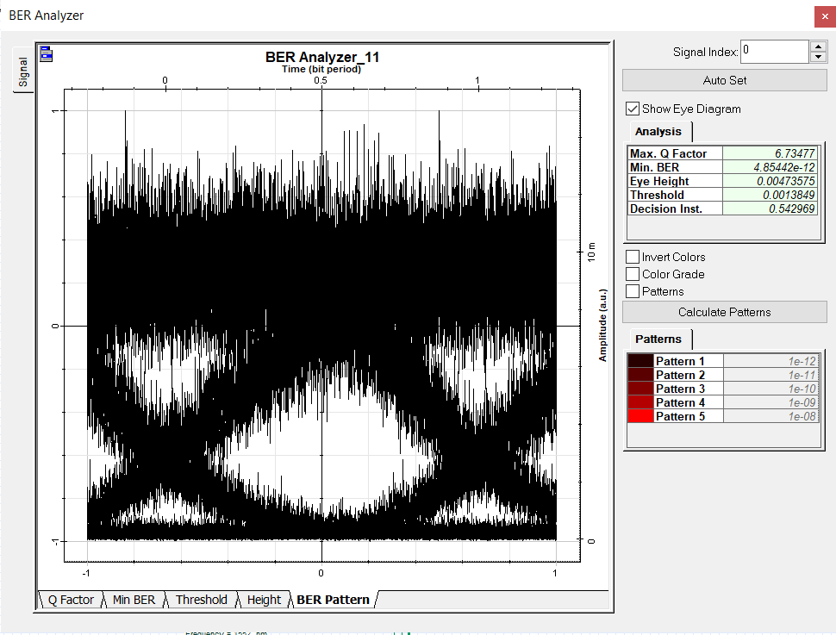
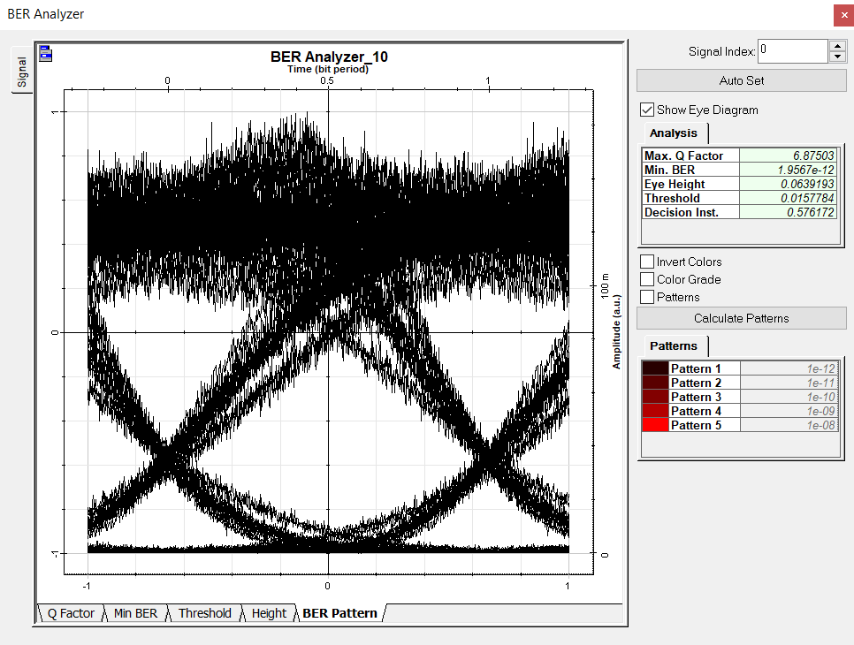
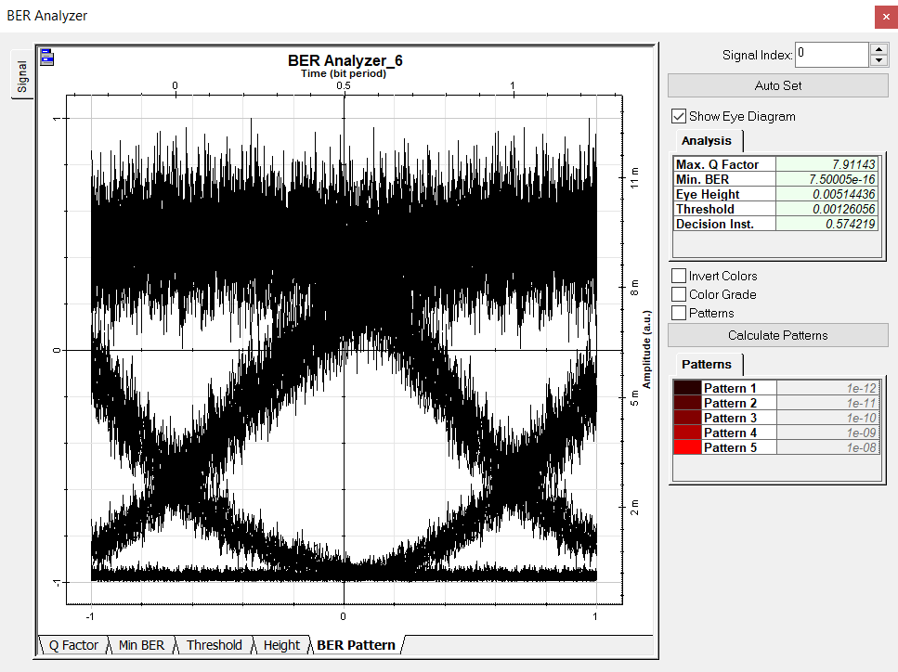
The Received output eye diagrams at different nodes for clear season

Slide 23
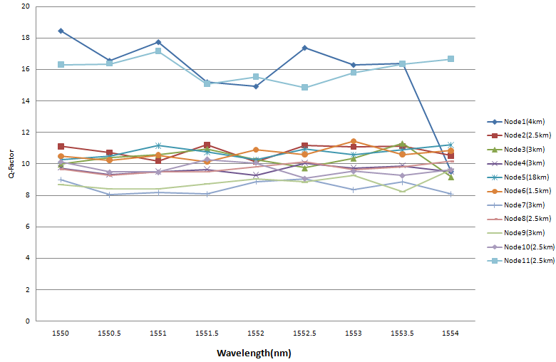
Graph of Q factor with respect to the used wavelengths at each node for hasty season.

Slide 24
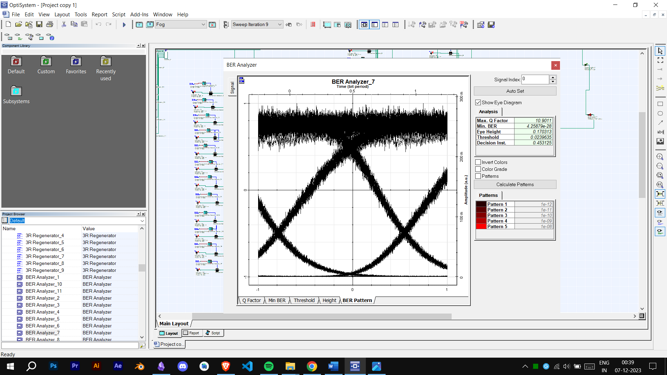
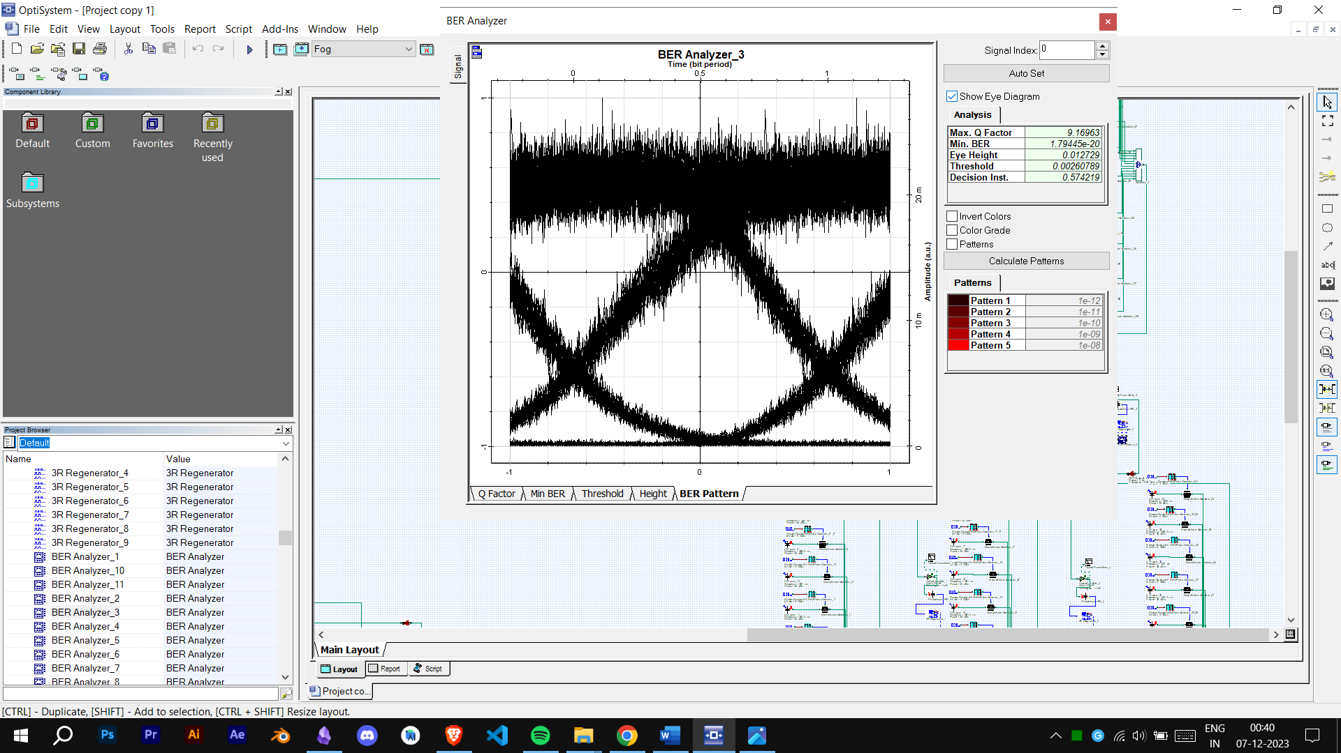
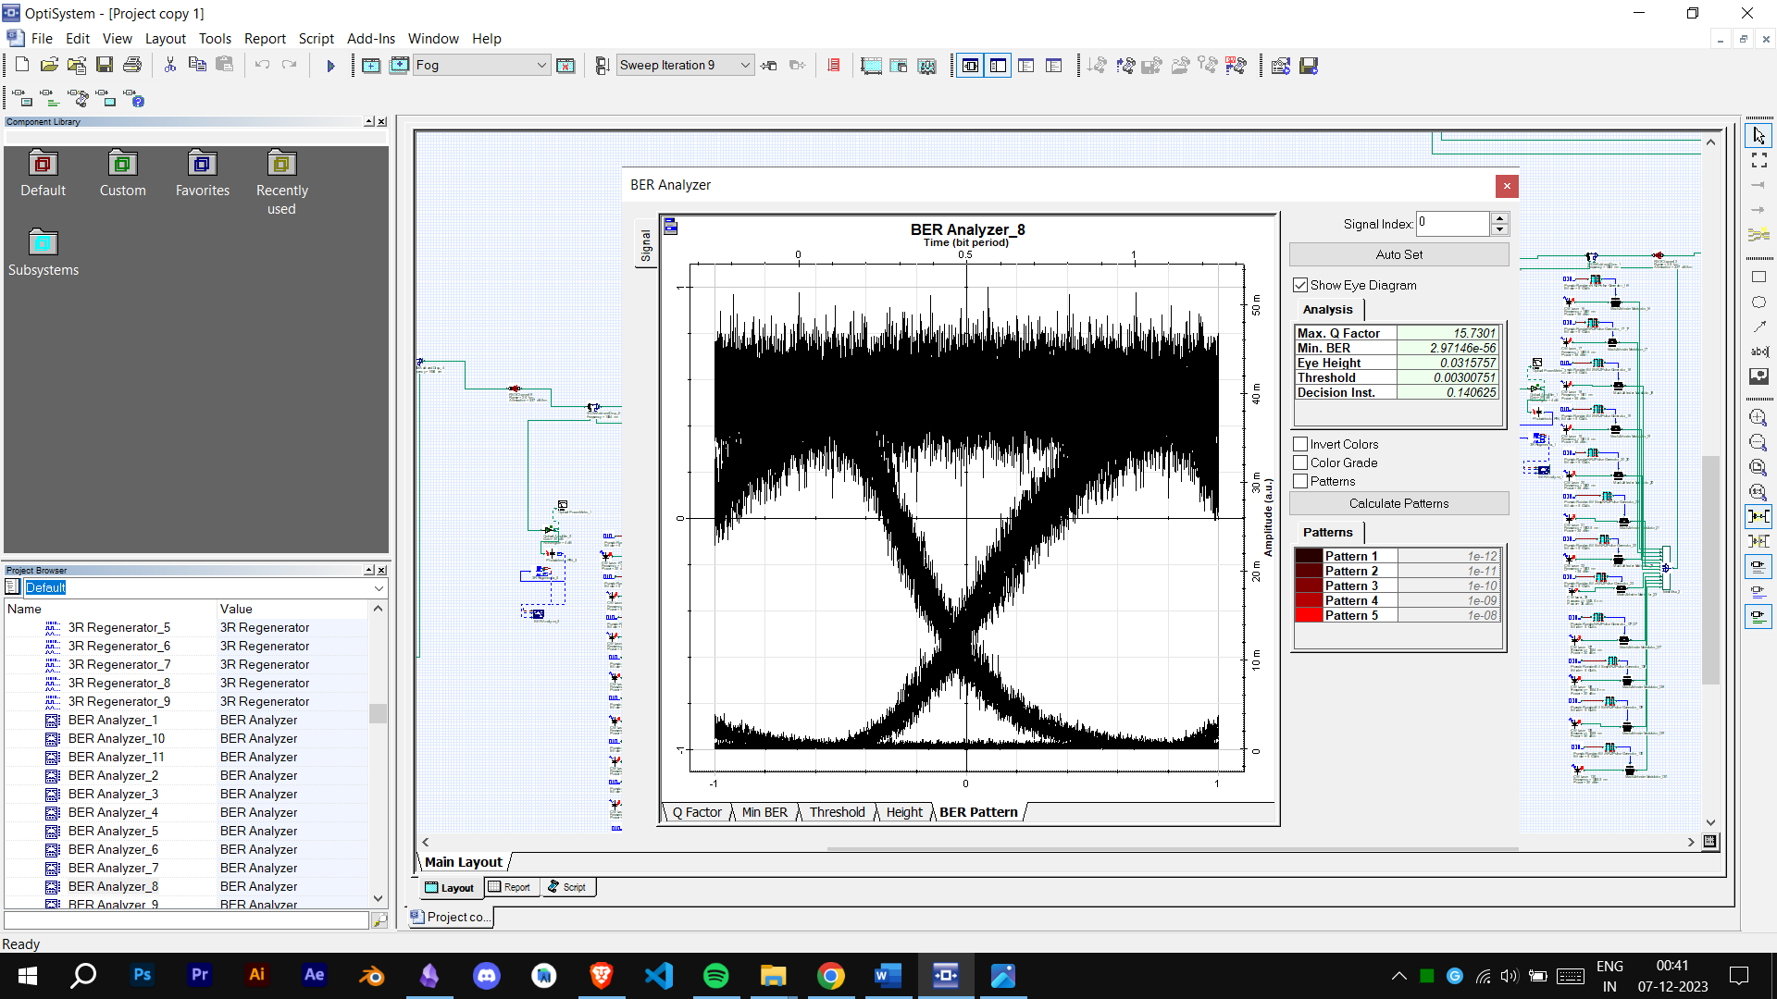
The received output eye diagram (1550 nm) at different nodes for hasty season

Slide 25
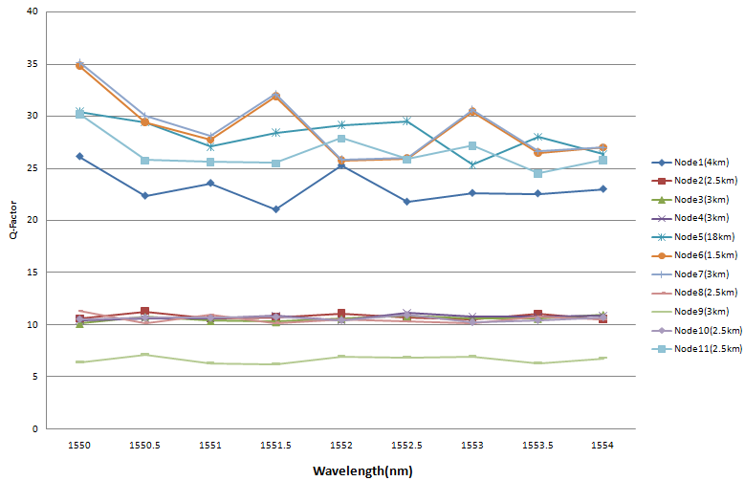
Graph of Q factor with respect to the used wavelengths at each node for rainy season.

Slide 26
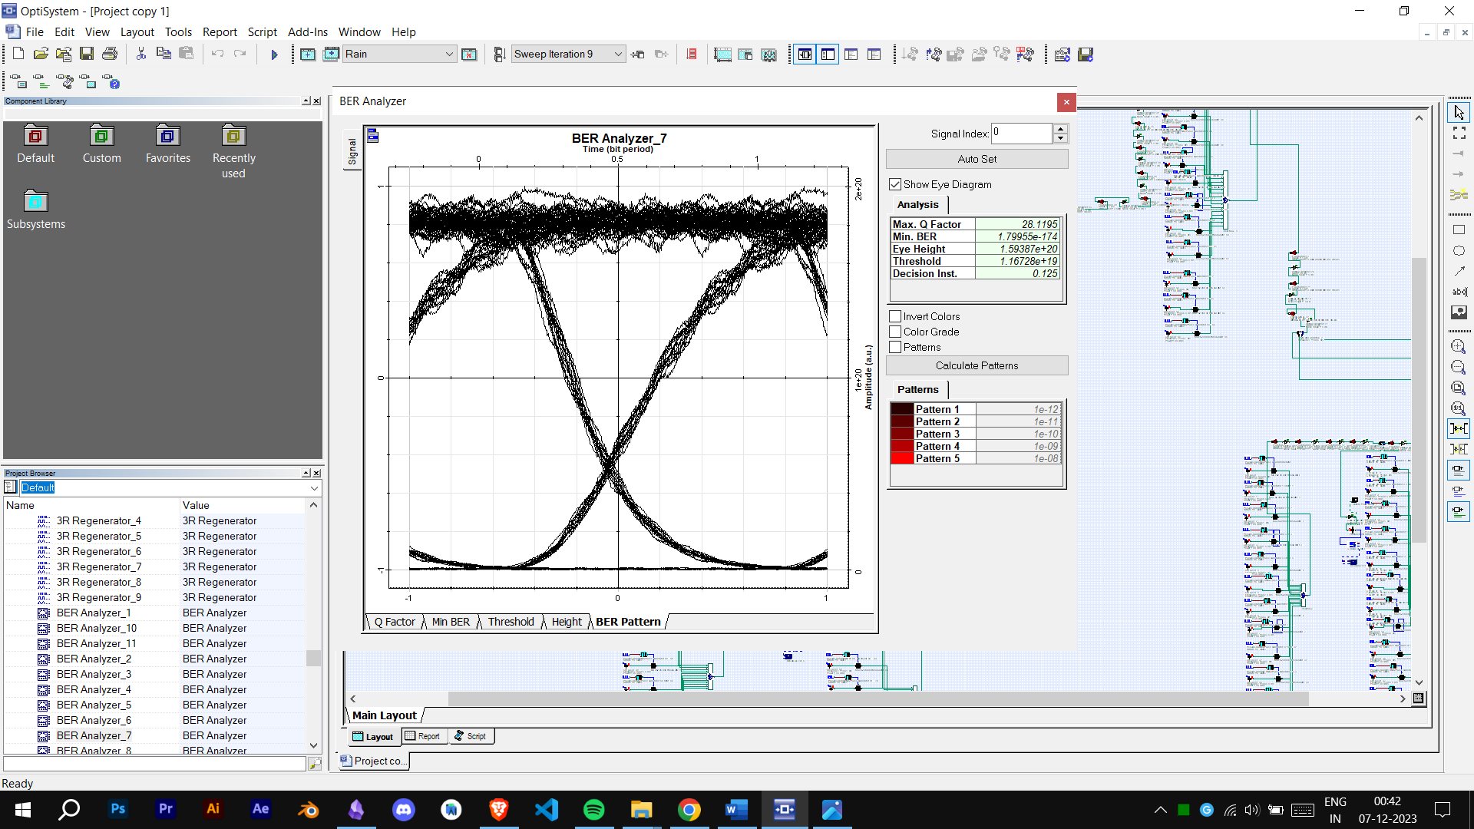
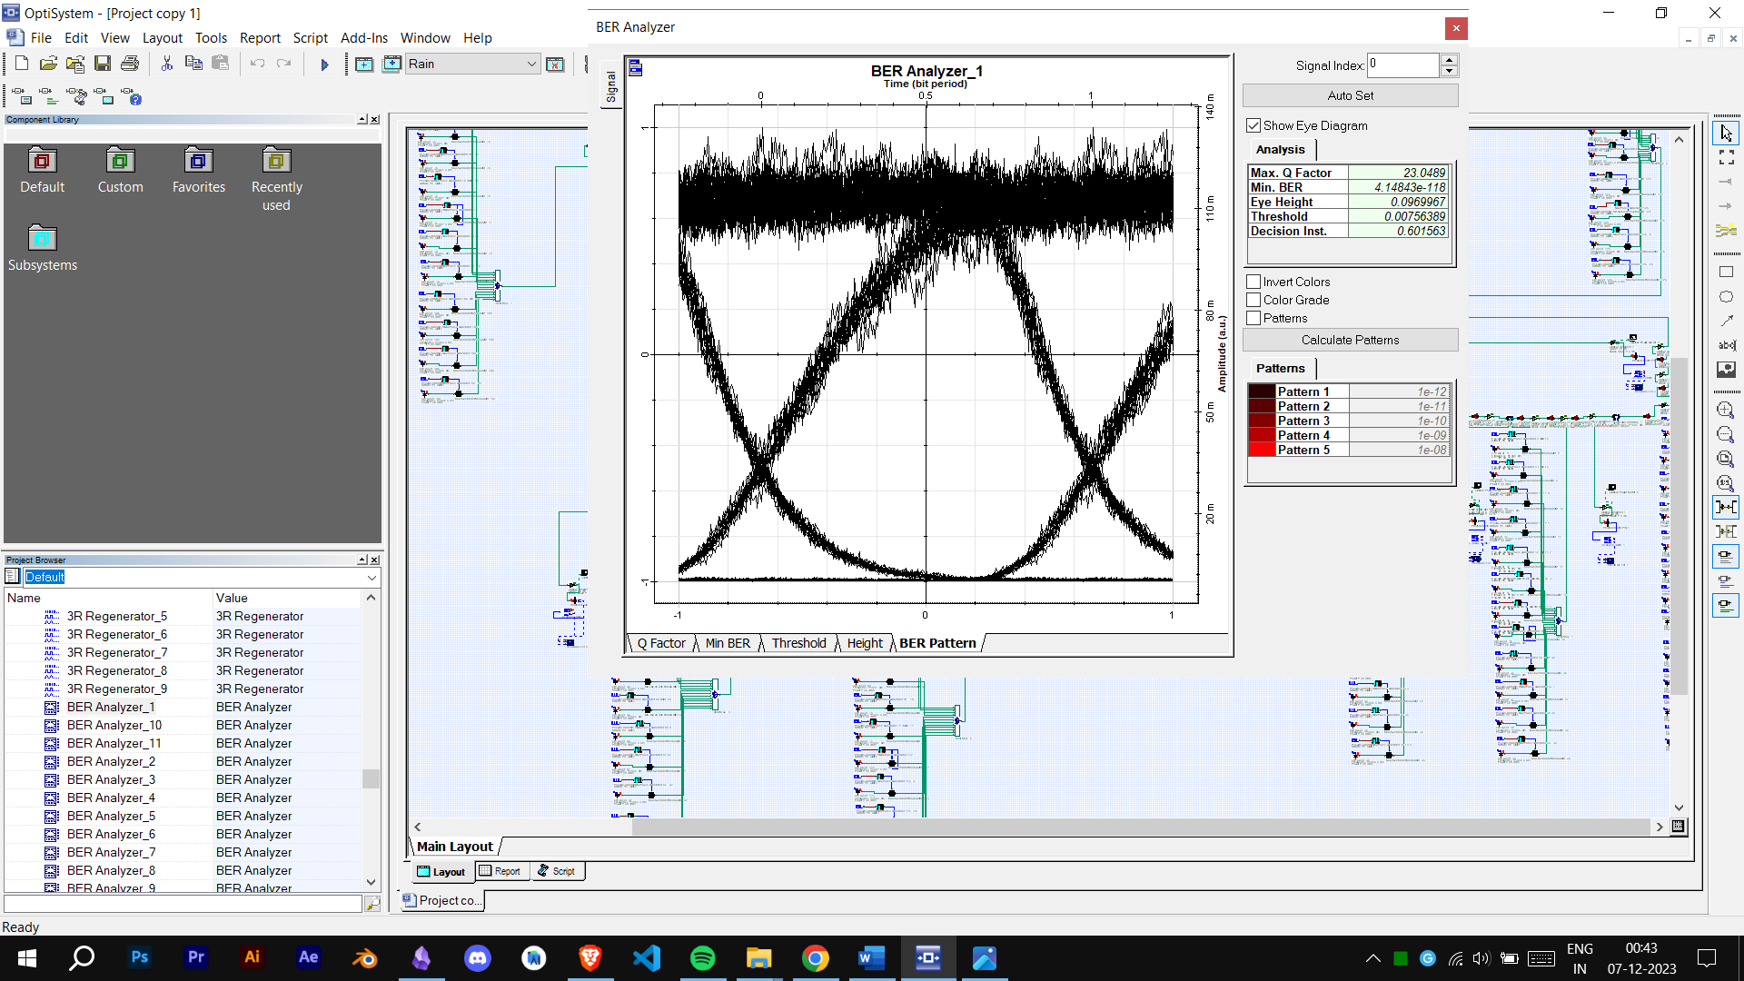
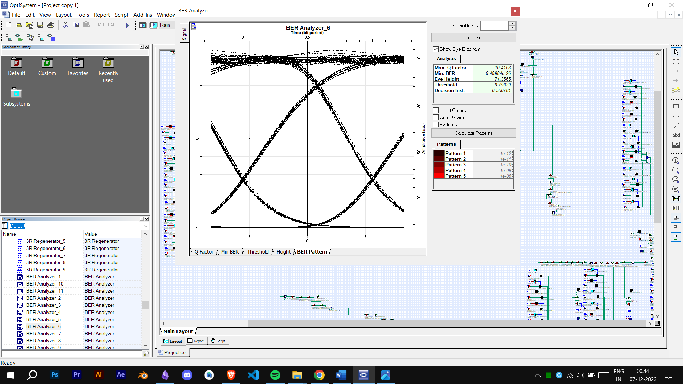
The received output eye diagram (1550 nm) at different nodes for rainy season.

Slide 27
Conclusion
FSO communication network has been proposed throughout the Dwarka and India Gate region.
The FSO communication link performance through all-weather seasons of Dwarka and India Gate region has been observed.
In all the weather seasons, the results at each node of the network have been calculated in terms of BER and Q-Factor.
In rainy season, repeaters are needed after every 1 km.
Acceptable quality factor on every node.

Slide 28
REFERENCES
1. J. Kaufmann, “Free space optical communications: an overview of applications and technologies,” in Proceedings of the Boston IEEE Communications Society Meeting, 2011.
View at: Google Scholar
2. H. A. Willebrand and B. S. Ghuman, “Fiber optics without fiber,” IEEE Spectrum, vol. 38, no. 8, pp. 40–45, 2001.
View at: Publisher Site | Google Scholar
3. V. Sharma and G. Kaur, “High speed, long reach OFDM-FSO transmission link incorporating OSSB and OTSB schemes,” Optik, vol. 124, no. 23, pp. 6111–6114, 2013.
View at: Publisher Site | Google Scholar

Slide 29
4. V. Sharma and G. Kaur, “High speed, long reach OFDM-FSO transmission link incorporating OSSB and OTSB schemes,” Optik, vol. 124, no. 23, pp. 6111–6114, 2013.
View at: Publisher Site | Google Scholar
5. R. K. Z. Sahbudin, M. Kamarulzaman, S. Hitam, M. Mokhtar, and S. B. A. Anas, “Performance of SAC OCDMA-FSO communication systems,” Optik, vol. 124, no. 17, pp. 2868–2870, 2013.
View at: Publisher Site | Google Scholar
6. G. Shaulov, J. Patel, B. Whitlock, P. Mena, and R. Scarmozzino, “Simulation-assisted design of free space optical transmission systems,” in Proceedings of the Military Communications Conference (MILCOM '05), vol. 2, pp. 918–922, Atlantic City, NJ, USA, October 2005.
View at: Publisher Site | Google Scholar

